Slide 1
Database modeling
Labib Fawaz

Slide 2
Outline
Relational Database Management Systems
NoSQL Databases
MongoDB
Introduction to Hadoop

Slide 3
RDMS
Focus on ACID Transactions
Atomicity: Everything in a transaction succeeds or it is rolled back
Consistency: A transaction cannot leave the database in an inconsistent state
Isolation: Once Transaction cannot interfere with the other
Durability: A completed Transaction persists, even after the application restarts

Slide 4
RDMS Design

Slide 5
RDMS Design

Slide 6
Approach
Identify Actors: Various actors in the application
Define Model: one to many relation between actors and models
Define Database entities: Defining tables, columns, column types
Define Relationship: One-to-one, one-to-many, many-to-many
Example:
Actors: customers, employees, vendors, inventory.
Model: User profile, Department, products categories.
Entities: Customers, Revenue, Geography, Date
Relationship: Customers belongs to city buys product on specific date

Slide 7
Challenges
Schema flexibility: Adding entities requires rethinking you model
Complex Queries: Customer A buys product B on date X requires joining 3 tables. Join are expensive
Data update: Updating data across tables can be challenging
Scalability: You have to expect database growth

Slide 8
NoSQL
NoSQL: Defined as “Not only SQL” – Structured Query Language. Is a broad class of database management systems identified by its non-adherence to the relational database management system models.
Meaning: They are not built on tables and don’t use SQL for data manipulation

Slide 9
So how do NoSQL Databases Store Data
Documents: MongoDB, CouchDB
Key-Value: Redis, Membase, Voldemort, MemcacheDb
XML: BaseX, eXist
Column: BigTable (google), Hadoop/Hbase (most popular), Cassandra
Graph: Neo4j, FlockDB, InfiniteGraph

Slide 10
Approach
Understand your Queries instead of understanding your business

Slide 11
Advantages
Flexible Schema: Store data as columns or documents instead of as rows
Complex Queries: Less joins means queries return faster
More Scalable: When you need more space or processing power just add a new cluster
Lower Maintenance: Partitioning and rebalancing is automatic

Slide 12
Drawbacks
No Joins
Inability to define relationships
Can’t enforce data integrity
Less control on database administration
Potential Loss of data
Less Database functionality, indexing, stored procs, functions

Slide 13
MongoDB
Document Database (JSON)
Stores collections instead of tables
Stores objects instead of rows

Slide 14
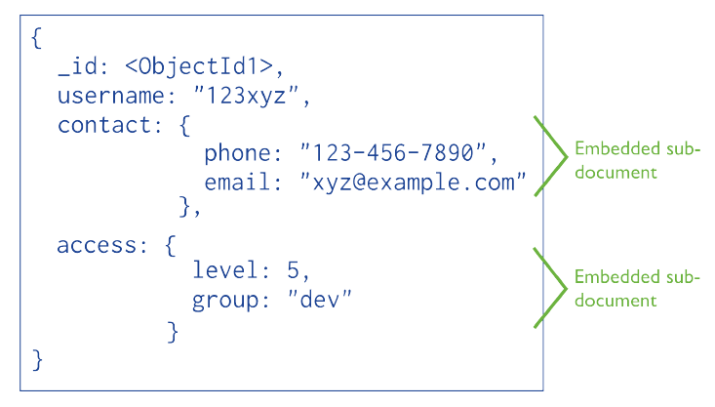
Create
You create a collection by inserting an object
Different objects in the same collection can have different structure

Slide 15
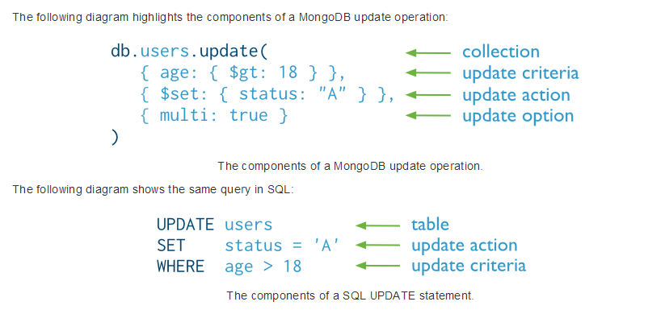
Mongo vs SQL

Slide 16
Schema Design Consideration
Using subdocuments versus separate documents
Store embedded data in arrays versus by nested document
Fewer large document versus numerous small document
De-normalize vs Normalize

Slide 17
Administration (Sharding)
Breaking up collections in smaller “chunks”
Picking a user-specified field “shard key”
Distributing “chunks” across shards
Store data you read at once on one shard and data you insert at once in different shards

Slide 18
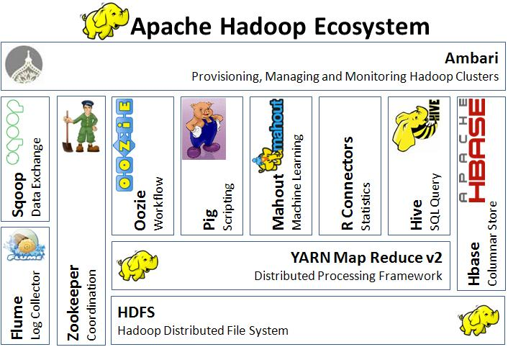
Hadoop Ecosystem
Storage:
- HDFS
- HBASE
- Hcatalog
Processing:
- MapReduce
- Pig
Querying
- Hive
External Integration
- Flume
- Sqoop

